Slide 1



Captsone Project
View in Power BI
Last data refresh:
6/16/2025 10:22:23 AM UTC
Downloaded at:
6/16/2025 10:26:19 AM UTC

Slide 2
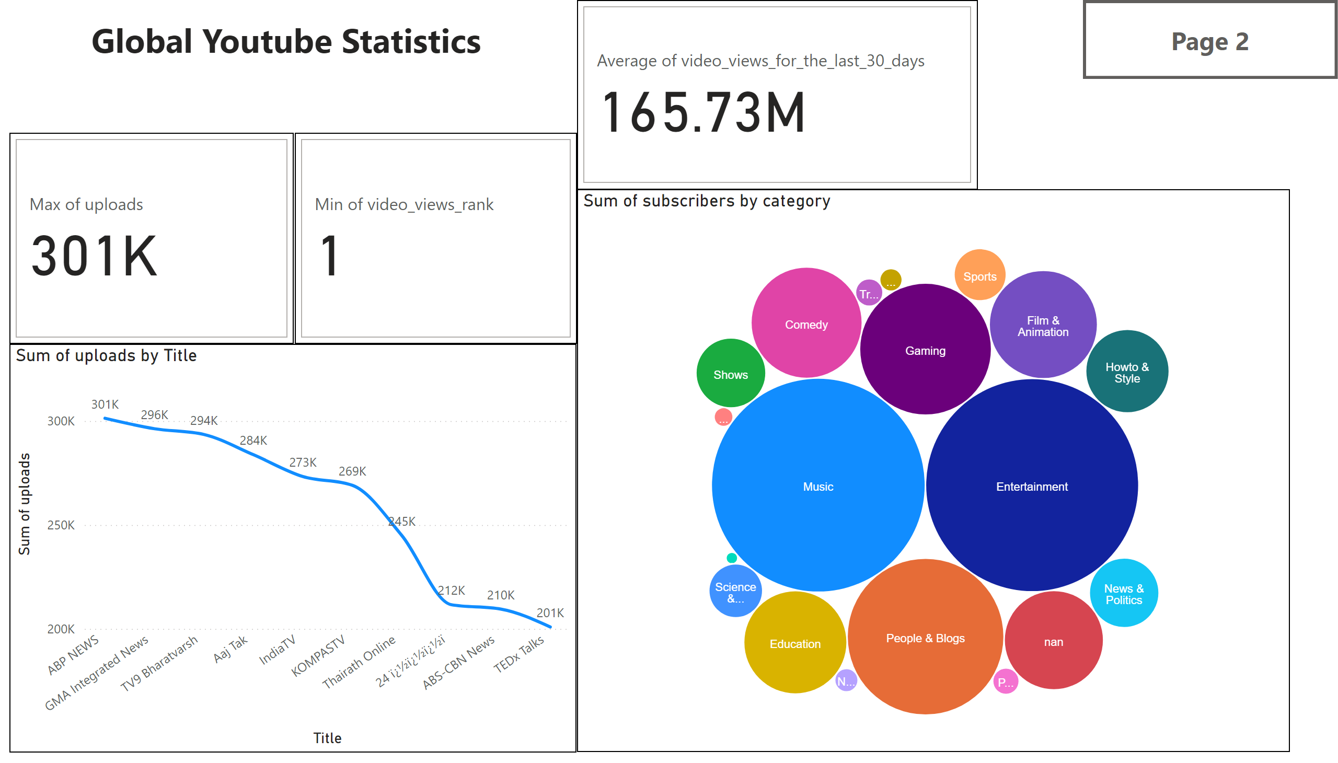
Main
Notes:
cardVisual
No alt text provided
cardVisual
No alt text provided
cardVisual
No alt text provided
lineChart
No alt text provided
bubbleChartEEDCDFA388784AEEAB47972BC1626196
No alt text provided
actionButton
No alt text provided
textbox
No alt text provided

Slide 3
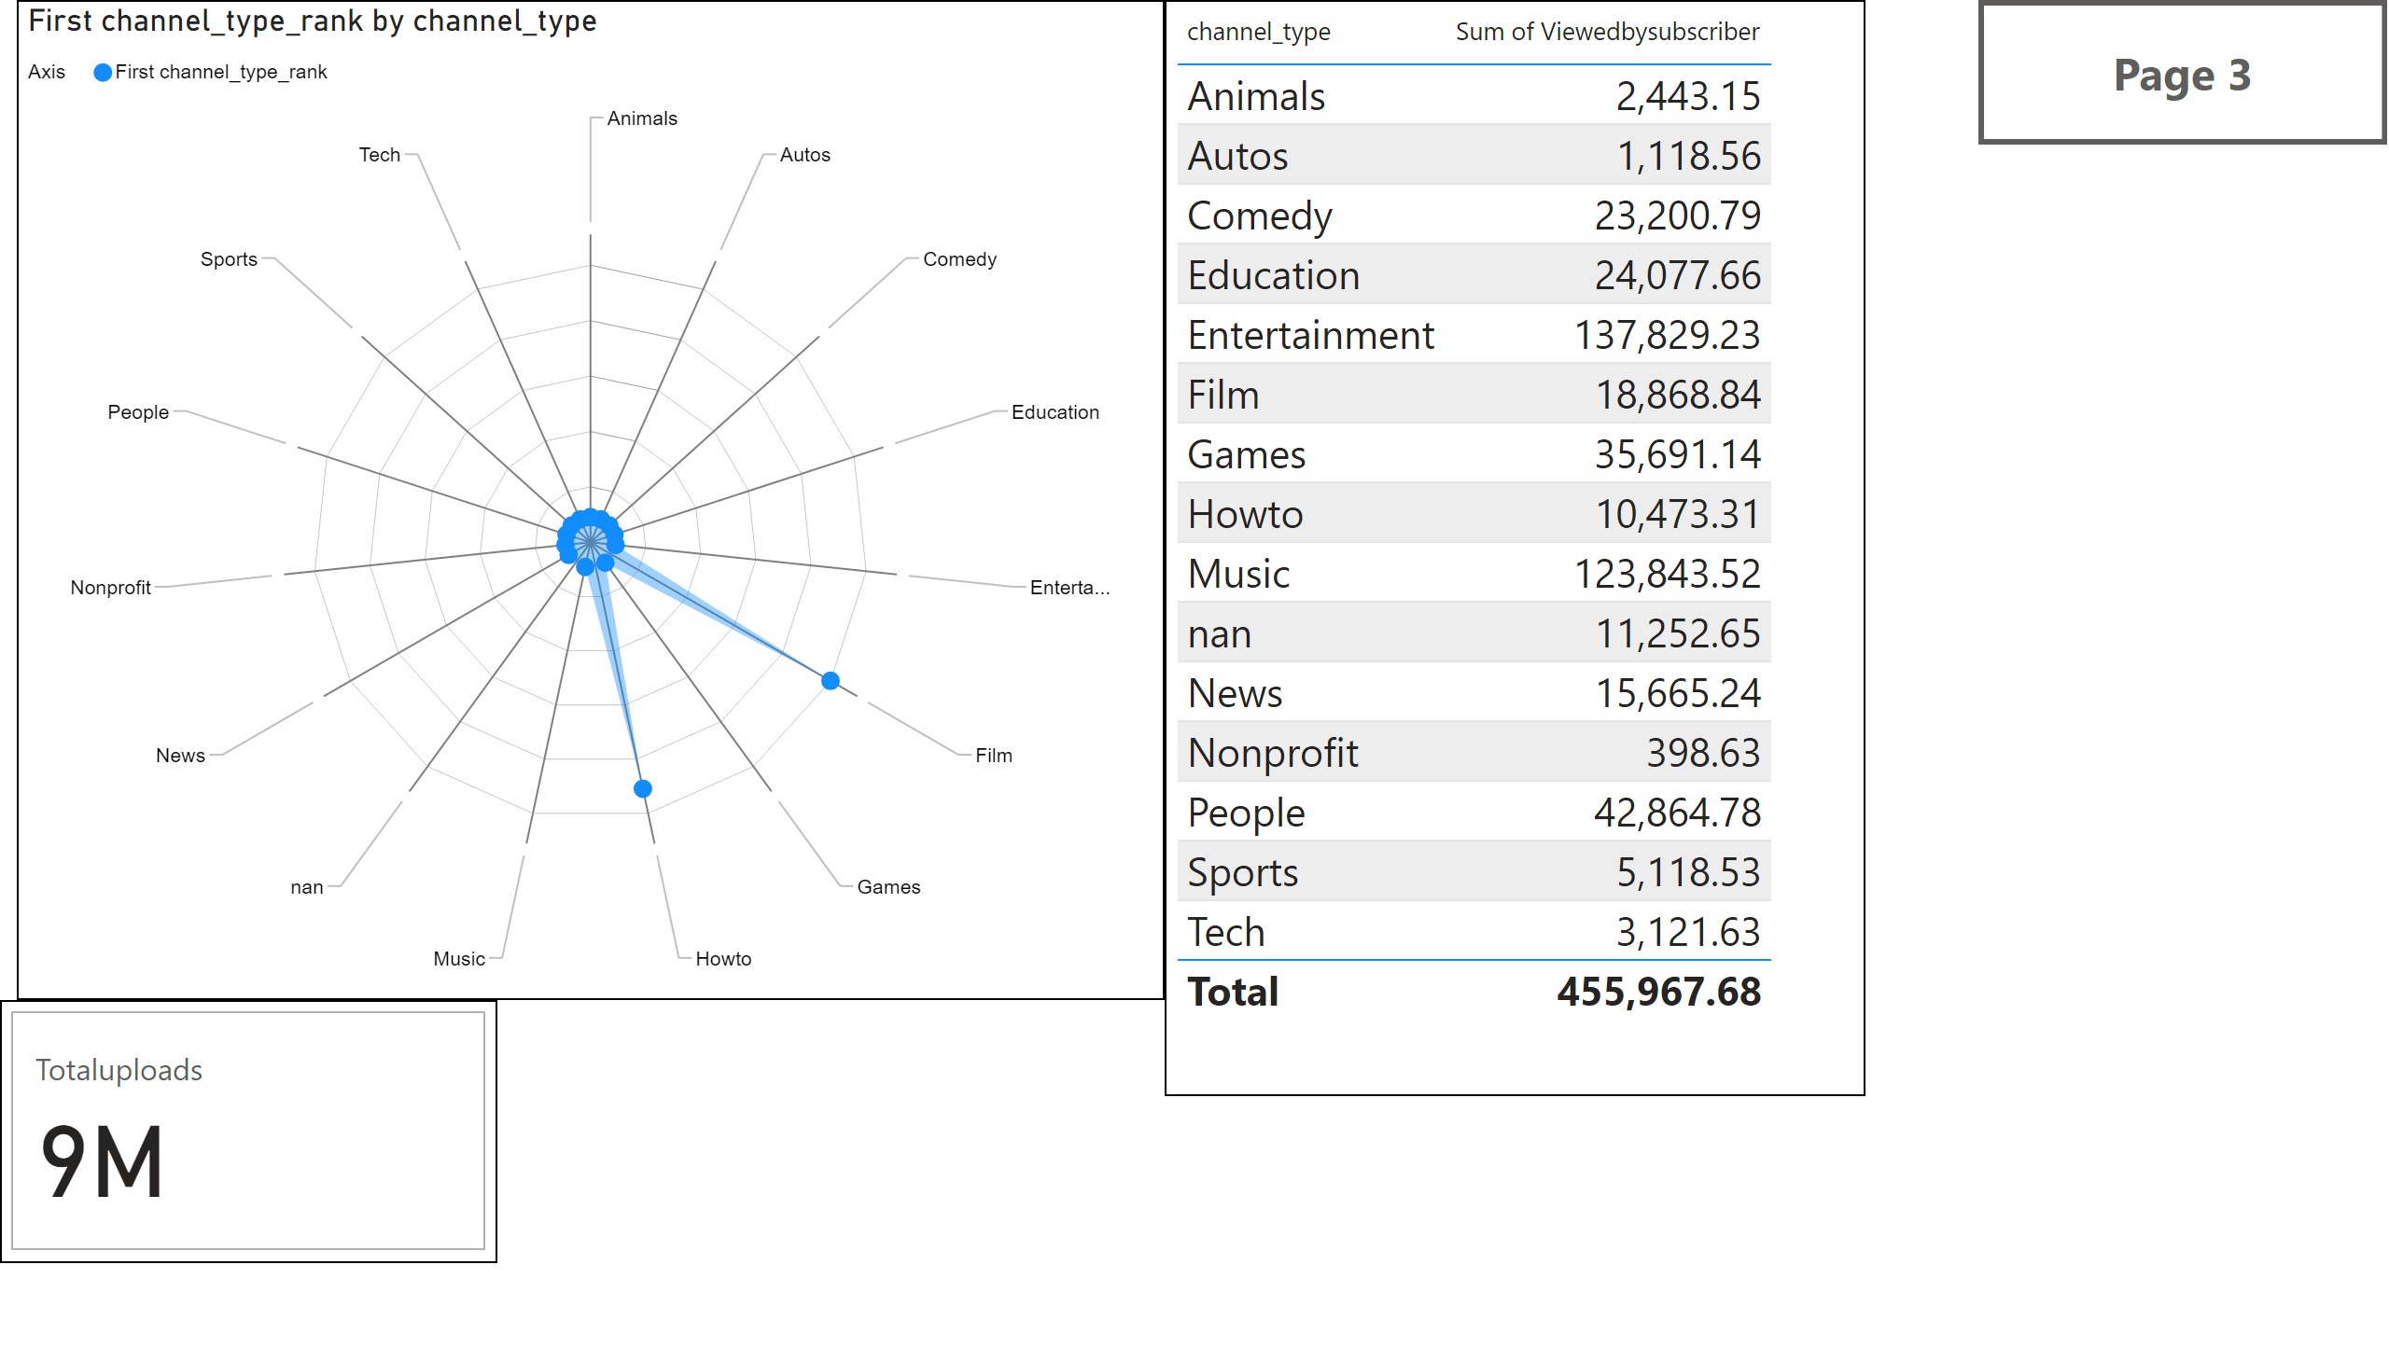
Radar chart
Notes:
RadarChart1446119667547
No alt text provided
tableEx
No alt text provided
cardVisual
No alt text provided
actionButton
No alt text provided

Slide 4
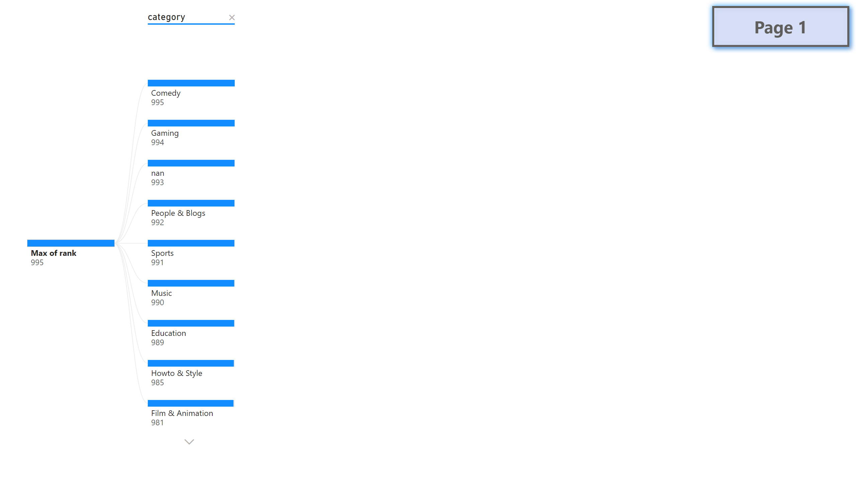
Rankwise and navigator buttons
Notes:
decompositionTreeVisual
No alt text provided
actionButton
No alt text provided

